Slide 1
Multimodal Learning and Reasoning for Visual Question Answering
MSc Project Demonstration
Vasin Srisupavanich
MSc Artificial Intelligence 19/20
Supervisor: Dr Srinandan Dasmahapatra
2nd Examiner: Professor Eric Rogers
Notes:
Hello, This is Vasin Srisupavanich. This is my MSc project entitled multimodal learning / and reasoning / for visual question answering.

Slide 2
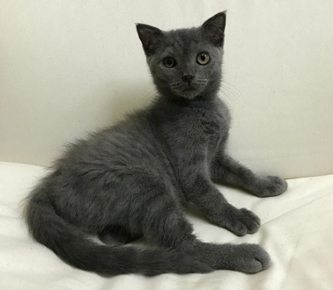
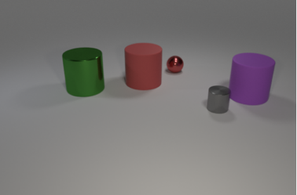
Motivation
Current artificial neural networks are very good at pattern recognition but not so good at reasoning.
R-CNN
cat
Object recognition
Object detection
Notes:
I am going to start by stating the motivation for my topic.
Current deep learning models are very good at pattern recognition.
For example, image recognition and object detection
Given this image, the model can classify that this is a cat with high accuracy.
Similarly, deep learning model, such as R-CNN can also detect object with high accuracy.
But, they are still not very good in tasks that requires high level reasoning skills or tasks that require multi-step inferrence.
for example counting, understanding the relationship between objects or making comparision between objects
So this is the topic that I am very interested in.
researching how to improve the reasoning capabilities of ANNs.

Slide 3
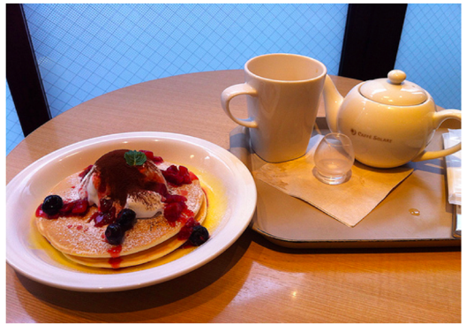
Overview
Visual Question Answering (VQA)
What colour are her eyes?
What is the mustache made of?
Visual Reasoning
Is there any fruit to the left of the tray the cup is on top of?
Are the napkin and the cup the same colour?
Computer Vision
Natural Language Processing
Reasoning
VQA/ visual reasoning
Notes:
First of all, I’m going to state the overview of this project. So, I chose to study about how to improve the reasoning capabilities of deep learning model in the context of visual question answering (VQA) and visual reasoning.
Visual Question Answering (VQA) is an emerging research problem at the intersection of computer vision, natural language processing and knowledge reasoning.
This is challenging because
A VQA task is usually framed as a classification problem.
Where the list of all possible answers in the dataset are taken as the targets for supervised training.
For this project, on the other hand, the task that I am focusing on is the visual reasoning.
It can be considered to be sub-task of VQA, but with more emphasis on evaluating the reasoning capabilities of deep learning models.
Object and attribute recognition
Transitive relation tracking
Spatial reasoning
Logical inference
Counting
Making comparisons

Slide 4
Aims and Objectives
Objectives
Study existing deep learning models for VQA and visual reasoning
Explore recent approaches which extend the reasoning capabilities of artificial neural networks
Aim
Develop a new VQA model based on Transformer architecture
Utilising self-attention and co-attention mechanism
Notes:
The initial objectives of this project is to study existing deep learning models for VQA and visual reasoning
As well as to explore recent approaches which extend the reasoning capabilities of artificial neural networks
Such as attention mechanism
After initial researches, I found the Transformer architecture to be the most promising.
As recently, deep learning models based on Transformer (e.g. BERT and GPT) have achieved positive results in various NLP tasks, including question answering, machine translation and text generation,
Given this, the main aim of this project is to develop a new VQA model based on Transformer architecture.

Slide 5
Model Details
Multimodal Transformer
CNN
Notes:
Now, I am going to talk about the details of the model that I developed.
The architecture of the model consists of three main components
input feature extractors
a stack of multimodal Transformer layer (Nx)
multimodal fusion layer and a classifier
The input feature extractors (CNN, LSTM) and the classifier components are similar to most existing VQA models.
The main difference between other models is how I stack these two transformer module together, and the use of special tokens, the [IMG] and [TXT] tokens
To extract the image features, I used the pre-trained ResNet architecture.
And to extract the question feature, I used GloVe word embedding and bidirectional LSTM.
As shown here, I also inserted the [IMG] and [TXT] tokens at the beginning of each sequence.
These are added to extracted the information related to answer from both visual and textual input in the Transformer layer.
The multimodal Transformer encoder block consists of two components: standard Transformer layer (TRM) and Co-attention Transformer layer
These two layers are based on multi-head attention concept. However, in Co-TRM layers, the keys and values from each modality are swapped
As we can see here, the output of [IMG] and [TXT] tokens from the final layer of multimodal Transformer are used as the pooled representation of image and question.
They are fused by element-wise products and are sent through the classifier layer to obtain the answer.

Slide 6
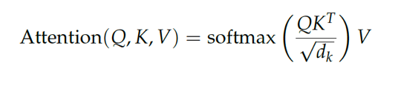
Background - Transformer
Self-attention
Notes:
Before I talk about the model I developed for a VQA task, let me give the background of the Transformer architecture.
Transformer is designed for sequence processing task.
But unlike an RNN, it is entirely built on self-attention mechanism to draw global dependencies between input and output
self-attention is an attention mechanism relating different positions of a single sequence in order to compute a representation of the same sequence
Self-attention in transformer relies on the scaled dot-product attention to compute the attention score between each word and every other word.
First, the input sequences are projected into three matrices: Query. (Q), Key (K), and Value (V),
Then dot product between query and key (QKT) is performed to discover the attention score between each input element and all other elements.
The attention scores are divided by the square root value of the key dimension to stabilize gradients during training.
Then the softmax function is applied to the scaled attention score to ensures that the weights are sum to 1.
Finally, the outputs are represented as the weighted sum of the value vector (V).
Rather than only computing the attention once, Transformer performs scaled dot-product attention multiple times in parallel.
This is called multi-head attention.
So this allows the model to jointly attend to information from different representation subspaces at different positions”
This was basically the main component of the Transformer architecture, and what makes them work so well in sequence processing task.

Slide 7
Background – Transformer (Cont.)
BERT
Visualisation of Self-attention
Notes:
The model know which word "it" refers to.

Slide 8
Experiment
CLEVR & GQA DATASETS - EXPERIMENTATION AND RESULTS
Notes:
Let’s look at the experiment

Slide 9
Datasets
CLEVR
850K automatically generated questions
GQA
100k synthetic images of 3D-rendered objects
20M compositional questions
113k real-world images
Notes:
In this project, I used two visual reasoning datasets,
The first one is the CLEVR dataset
It contains 850K generated questions
With 100K synthetic images
3 shapes (cube, cylinder, and sphere)
2 materials (shiny “metal” and matte “rubber”)
2 sizes (small and large)
8 colours
The second dataset I used is called the GQA dataset
It contains 20 million questions with 113K real-world images
Compare to the CLEVR dataset it contains a larger semantic space
It has a lot more variety of attributes and object types
In this dataset there are 1878 possible answers
These are designed to test various high level reasoning, such as spatial reasoning, counting, and making comparision.
As shown here, the question are highly compositional and requires multi-step inferences

Slide 10
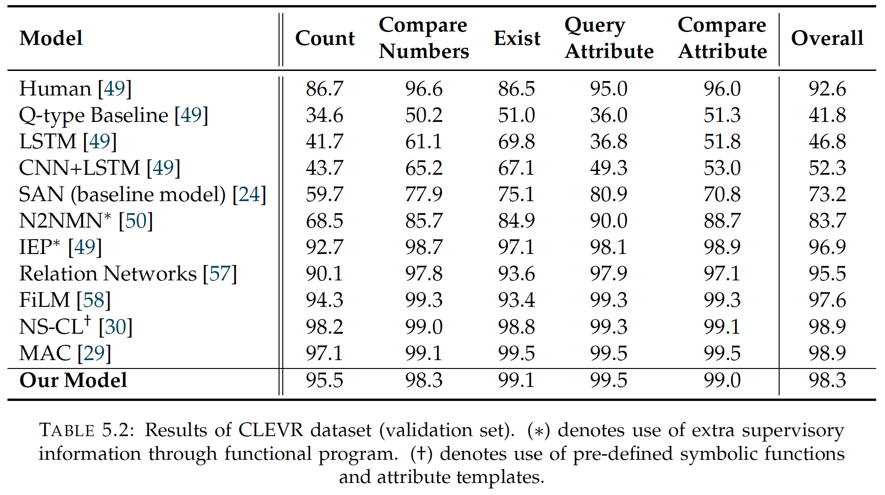
Results - CLEVR dataset
Notes:
This is the result on the CLEVR validation set
The model was able to achieve the overall accuracy of 98.3%. And consistently perform well on all the question types
This accuracy is comparable to current state-of-the-art models, which are designed for a reasoning task.

Slide 11
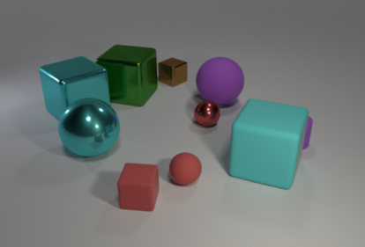
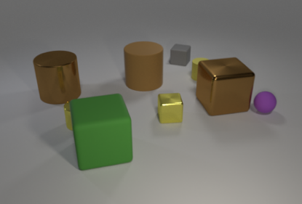
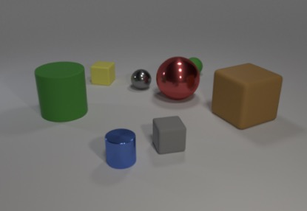
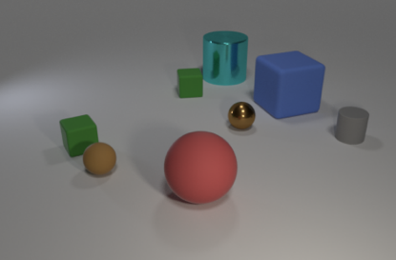
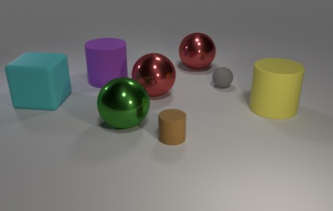
Qualitative results - CLEVR
How many other things are there of the same shape as the green thing?
Answer: 3 Prediction: 3
Are there any large balls that have the same material as the tiny red cube?
Answer: yes Prediction: yes
What number of objects are the same colour as the tiny metal cylinder?
Answer: 2 Prediction: 1
There is a small gray matte thing: what shape is it?
Answer: cube Prediction: cube
Is the number of big matte blocks greater than the number of tiny red metal cubes?
Answer: yes Prediction: yes
What number of large shiny balls are left of the small cylinder and behind the matte cube?
Answer: 1 Prediction: 0
Notes:
Here are some of the correct and incorrect predictions made by the models.

Slide 12
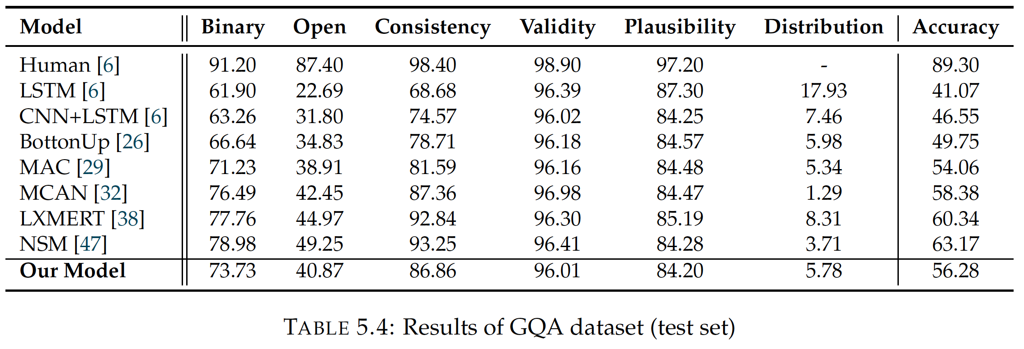
Results - GQA dataset
Notes:
For GQA dataset, the model achieved the accuracy of 56.28%. This percentage is higher than baseline methods, such as BottomUp model
and MAC Network.
Nevertheless, I believe that the accuracy could still be further improved, with larger model size and more extensive hyperparameter search.
Because of time constraint, I did not have the chance experiment with other settings of hyper parameters.

Slide 13
Qualitative results - GQA

Slide 14
Analysis
CLEVR - ANALYSIS AND CONCLUSION

Slide 15
Analysis
Analysis of the model on CLEVR dataset
Visualising the attention distributions produced by the model during the inference process
To obtain insights into the underlying reasoning process of our model
Understand why the model make mistakes (error analysis)
Attention distribution of the [IMG] and [TXT] tokens across all the layers and attention heads.
Notes:
I also perform the analysis of the model to understand how the model comes up with an answer.
For simplicity, I chose the CLEVR dataset.
To do this, I visualise the attention maps across all the layers and attention heads of the [IMG] and [TXT] tokens
The attention distribution of [IMG] token should reveal which specific parts of the image the model is looking at.
On the other hand, the attention distribution of the [TXT] token can reveal which words in the question the model is focusing on.
Show highly critical information

Slide 16

Analysis – Human Behaviour
Find green thing
Identify its shape
Locate other objects with the same shape
Count all the located objects
How many other things are there of the same shape as the green thing?
Answer: 3
Notes:
Most of the questions required the ability to perform multi-step reasoning
For this example, if the question is how many other things are there of the same shape as the green thing?
To correctly answer this question, as human,
we would first need to locate the green thing and identify its shape before It can counts other things
Then we need to find other things with the same shape
and finally count the objects.

Slide 17
Analysis (1)
How many other things are there of the same shape as the green thing?
Answer: 3
Prediction: 3
Notes:
here we can see how the model looks at an image to come up with an answer
Brighter region of the image indicates higher attention weight
Surprisingly, the VQA model also shows this similar behaviour
In the first layer (layer 0), we can see that the model starts to look at the overall image, without specific focus on any of the object
2. Then in layer 1, the model is able to locate the green thing with high attention weight in most of the heads
3. In layer 2 and 3, it starts looking at other objects, with high attention weight in different region.
4. Then in layer 4, the model starts to identify the objects with the same shape, which is cube, as indicated in head 3 and 5.
5. Finally, in the last layer, the model becomes confident of the three objects, and provides correct answer.

Slide 18
Analysis (1)
How many other things are there of the same shape as the green thing?
Answer: 3
Prediction: 3
Notes:
darker orange indicates high attention on specific words in the question.
This visualisation of [TXT] also reveals certain patterns.
As shown here, the models tend to focus on keywords in the question.
In layer 1, 3 and 4, the model sharply focuses on the words “How many”
This is expected since this is a counting question.
The model also looks at the words “other thing” in layer 3, and “shape” in layer 2
As we can see, these are highly relevant keywords.

Slide 19
Analysis (2)
There is a large yellow metallic object; is it the same shape as the green thing that is behind the large gray shiny object?
Answer: no
Prediction: no
Notes:
Similar to the previous example, the model looks at all the objects in the image in the first layer (layer 0).
Then the model starts to look around different part of the image in layer 1.
Interestingly, the model looks at the all the objects behind the large gray cylinder, indicating that it understands the concept of “behind”, as shown in head
1 and 3 in layer 1.
Then the model is able to locate the green object in layer 2.
Finally, the model sharply attends to the small green sphere and large yellow cylinder in layer 3 and 4,
From this, it can already infer that the shape of these two objects are not the same.
So, in this example, layer 4 and 5 seem to be non-essential, as It doesn’t look for new information anymore

Slide 20
Analysis (2)
There is a large yellow metallic object; is it the same shape as the green thing that is behind the large gray shiny object?
Answer: no
Prediction: no
Notes:
darker orange indicates high attention on specific words in the question.

Slide 21
Analysis Summary
In the first layer of visual attention, the model tends to look at the overall picture.
It is able to learn the concept of spatial relation (left, right, in front, behind)
It can also focus on multiple objects with the same attribute at the same time.
It is adaptable to different difficulty level of question and image.
Notes:
I also looked at other image and questions, and found similar behavior from the model.
In the first layer of visual attention, the model tends to look at the overall picture, before focusing on specific objects in the following layers.
The model is able to learn the concept of spatial relation (left, right, in front, behind) as the visualisation show that it can focus on the correct region corresponding to the preposition.
It can also focus on multiple objects with the same attribute at the same time. This definitely helps with the model’s performance on counting questions.
4. It is adaptable to different level of question’s difficulty. For easier, in the last layers, the model doesn’t look for new information.

Slide 22
Error Analysis
What number of objects are the same color as the tiny metal cylinder?
Answer: 2
Prediction: 1
Notes:
Even though, the model makes incorect prediction, the inference process seems to be valid.
The model starts to look at the overall image,
Then focus on different objects in layer1-3
Interpretation is that it’s trying to find tiny metal cylinder
Surprisingly, the model is able to identify the tiny metal cylinder, which is almost entirely occluded.
Finally locate the correct object in final layers
However, even though the model focuses on the correct region, it produces an incorrect answer
Because the model can only see a small portion of the relevant objects, I think that the model is less certain about their colour.
I have also looked at other errors, and found that
In general,
1. most of the mistakes occur when the objects are highly overlapping.
2. The model also tends to give incorrect answer when the occluded object’s colour is yellow or brown, since they are quite similar.
3. But most of the time it focus on the correct regions of the image.

Slide 23
Conclusion
Visualisations show that the model learns to look around the image, and iteratively focus on relevant objects.
Shown one effective way to adapt the Transformer architecture for multimodal supervised learning.
Notes:
It is clear that the model is capable of multi-step reasoning.
To be honest, I didn't expect the multi-step reasoning process of the model to be this clear in the visualisation.
I also show one effective way to adapt the Transformer architecture for multimodal supervised learning
This is done by using both self-attention and co-attention, as well as adding special tokens, [IMG] and [TXT] as a pooling strategy.
To conclude, this project shows that deep learning models with the right inductive bias can learn to reason from raw data.
Apply this model to different tasks
Ok, that’s the end of my presentation. Do you have any questions?

